Slide 1


Fingerprint Vehicle Starter: Secure & Convenient Access
Introducing the future of vehicle security. Our fingerprint vehicle starter offers biometric authentication for keyless entry and ignition, providing enhanced security, personalized settings, and a seamless user experience. Join us as we revolutionize vehicle access with cutting-edge biometric technology.
by Navaneethakumar V

Slide 2
Traditional Vehicle Security Weaknesses
Rising Threats
Lack of Personalization
Key theft and fob hacking are on the rise, with a 15% increase YoY. Traditional keys are easily duplicated or lost, leading to security vulnerabilities and potential vehicle theft. The cost of replacing stolen keys can range from $200 to $800 on average, creating a financial burden for vehicle owners.
Traditional systems lack personalization in vehicle settings for multiple drivers. This results in a less convenient driving experience as each driver must manually adjust seat, mirror, and radio preferences every time they use the vehicle. This absence of personalized settings leads to inefficiency and driver dissatisfaction.

Slide 3




Biometric Authentication System
Integrated Scanner
User Profiles
Anti-Spoofing
Integrated fingerprint scanner on the door handle and ignition button for seamless access. High-resolution sensor with <0.5% False Acceptance Rate (FAR) ensures accurate authentication.
Stores up to 10 fingerprints per vehicle user profile, enabling personalized settings for multiple drivers. Encryption: AES-256 bit encryption for biometric data protects user information.
Liveness detection prevents fake fingerprints, adding an extra layer of security against unauthorized access. Enhanced security measures to safeguard against potential threats.

Slide 4





System Architecture: How It Works
Fingerprint Sensor Module
Captures and verifies fingerprint data.
Secure Microcontroller
Processes biometric data and manages access control.
Vehicle Control Unit Interface
Communicates with the car's ECU for seamless integration.
User Management System
Stores user profiles and settings securely.
The system architecture consists of the Fingerprint Sensor Module, Secure Microcontroller, Vehicle Control Unit Interface, and User Management System. Power consumption is <50mA in standby mode and <200mA during scan, ensuring energy efficiency.

Slide 5

Key Features and Benefits
Enhanced Security
Personalized Settings
Biometric authentication is harder to compromise, providing a higher level of security compared to traditional keys and fobs. Prevents unauthorized access and vehicle theft.
Driver profiles for seat, mirror, and radio preferences create a customized driving experience. Automatically adjusts settings based on the identified fingerprint for maximum comfort.
Keyless Convenience
Seamless entry and ignition with a touch, eliminating the need for physical keys. Simplifies vehicle access and enhances user convenience.

Slide 6




Market Opportunity
Addressable Market
Target Audience
90M new vehicles sold globally each year, creating a vast market for our fingerprint starter system.
Tech-savvy consumers, luxury car owners, and fleet managers who value security and convenience.
1
2
Competitive Advantage
Projected Market Share
Superior security and convenience compared to traditional systems, positioning us as a leader in vehicle access technology.
5% within 3 years, translating to $450M in revenue, indicating significant growth potential.
4
3

Slide 7
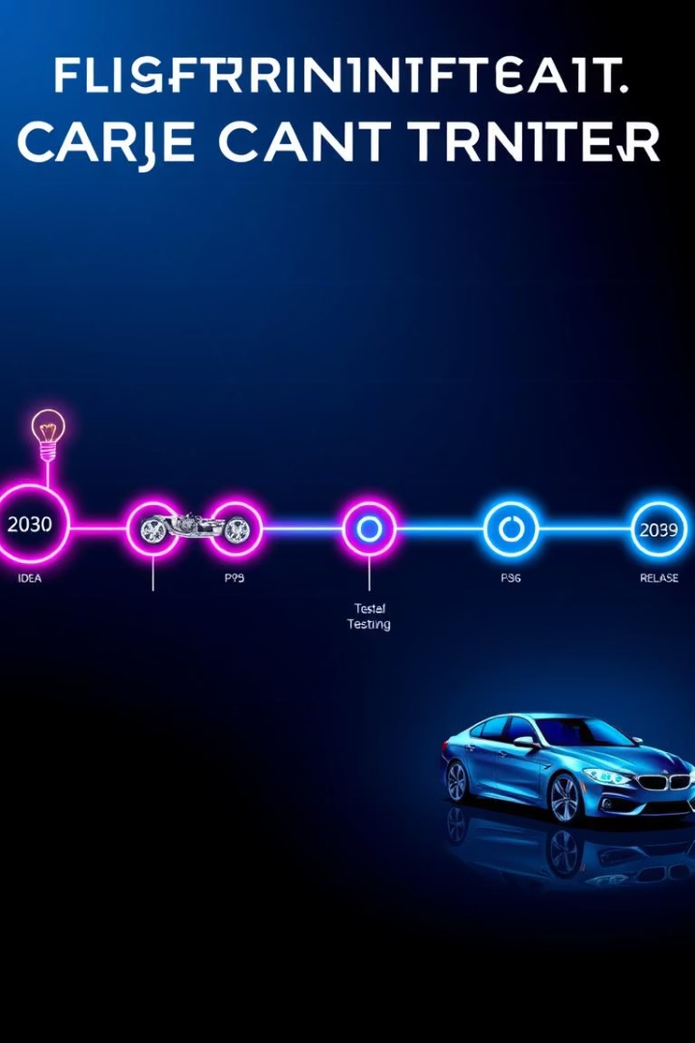
Development Roadmap and Timeline
1
Q1 2025
Prototype development and testing.
2
Q3 2025
Integration with vehicle ECU and user interface design.
3
Q1 2026
Pilot program with select automotive partners.
4
Q3 2026
Mass production and market launch.
Our development roadmap outlines the key phases and milestones for bringing our fingerprint vehicle starter to market. From prototype development and testing to mass production and market launch, we are committed to delivering a secure and convenient vehicle access solution.

Slide 8

Partner with Us
Secure the Future
Investment Opportunities
Secure the future of vehicle access with our fingerprint starter system, offering enhanced security and convenience.
Strategic Partnerships
Investment opportunities available for scaling production and marketing efforts to meet growing demand.
Seeking partnerships with automotive manufacturers to integrate our fingerprint starter system into new vehicles.
Contact us for demonstrations and further discussions on how we can collaborate to revolutionize vehicle access. Join us in shaping the future of automotive security.

